Slide 1
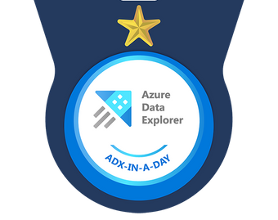

Welcome to Azure Data Explorer in a day

Slide 2

Agenda – High level
First Half
Intro (5 mins)
Presentation (1 hr)
Break (10 min)
Lab 1 Challenges 1-4
Lunch (30 mins)
Second Half
Regroup (5 mins)
Presentation (45 mins)
Break (10 mins)
Lab 2 Challenges (5-8)
Closing (15 mins)
Notes:
Agenda can be spread in-half across 2 days with a presentation and 2 labs.
Do Q&A throughout.
Start at 9:30 AM
Break 10min
Lunch at :01:00 PM
Back from Lunch at: 1:45 PM
Break 10 min
Close by 05:30 PM
1st Presentation – ADX intro, Positioning, Competes, Customer Stories, KQL, Schemas, Update Policies
2nd Pressenation - Presentation – ADX Schemas, Timeseries Analysis, Machine Learning

Slide 3
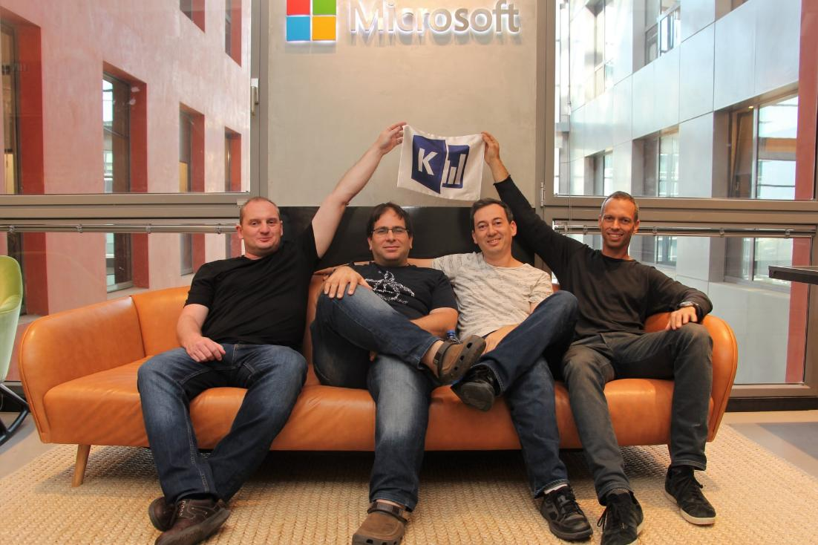
Necessity is the mother of invention
The story of Azure Data Explorer

Slide 4
Innovation
Text search capabilities (Inverted text index)
+
Performance & analytics (Column store DB)
Query agility Ad-hoc query language: SQL-like (tables, columns) + ability to “pipe” (flow) the data, from one operator to the next

Slide 5

















































Telemetry: Key data for digital transformation
Physical World
Manufacturing
Energy
Retail
Healthcare
Digital World
High Frequency
High Volume
High Velocity
Schema Drift
Semi-structured + Free Text
Immutable
Low Latency
Telemetry, timeseries, tags
Logs, traces, metrics
Telco
Automotive
Financial Services
Media & Entertainment
Audit Logs
Activity Logs
Access Logs
Notes:
Industries :
Telemetry from manufacturing industries- Locomotives, food processing equipment, Industrial IOT, smart buildings, connected factories
Energy customer using telemetry from power plants, wind turbines solar to perform analysis on plant performance and maintenance
Automotive industry uses ADX for racing telemetry, fleet management, real time road safety
Retail Industry to digitalize shopping carts, delivery tracking
Media and Entertainment to track clickstream data, ad campaigns, personalized content
Digital World:
Different kinds of logs and traces like Database logs, Security logs, audit traces, system events and more
Logs, traces, metrics, audit trails

Slide 6

Introducing Azure Data Explorer!
Any append-only stream of records
High volume
High velocity
High variance (structured, semi-structured, free-text)
Relational query model:
Filter, aggregate, join, calculated columns, …
Fully-managed
PaaS, Vanilla, Database
A big data analytics cloud platform optimized for interactive, ad-hoc queries
Purposely built
Rapid iterations to explore the data
Notes:
Big Data – Data that has High Volume, Velocity, variety – Structured, Semi-Structured, free text data. Append only DB.
Analytics – Can have relational query model with tables, columns, joins, filters and aggregates.
Cloud Platform – Platform as as Service where we don’t have to take care of infrastructure. With little configuration of Scale we can provision cluster, DB and start working with it. We can take care of scaling using autoscale or you can use manual scale.
Optimized – any data that is timestamped can fit right into ADX. It is optimized for timeseries data. All columns are compressed and indexed.
Interactive , ad hoc queries – ADX has native Kusto Query Language for gaining data insights. Has some similarity to SQL in terms of operators/joins etc Use KQL to – finding patterns, trends, forecasting, anomalies etc. Create near realtime dashboards

Slide 7
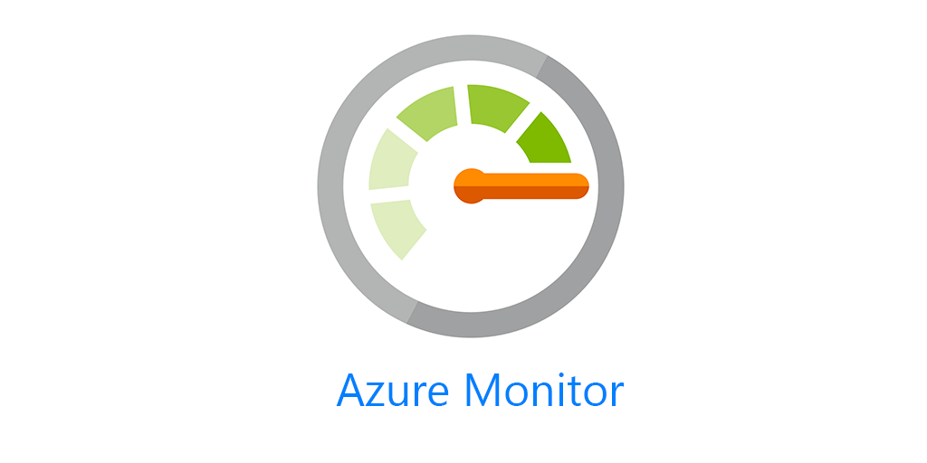



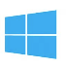






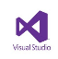
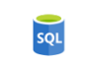


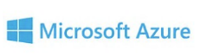



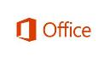




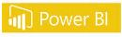


Proven Technology
In production since 2015 for internal Microsoft workload, GA since Feb 2019.
Battle tested for Microsoft internal workload
The platform for analytical solutions (SaaS)
Available as PaaS
Azure Monitor Log Analytics, Application Insights
Security Products (MS Defender for Endpoint (MDATP), MS Sentinel, MS Defender for IoT, MS Defender for Cloud Apps (MCAS))
Azure IoT Central
Gaming platform
https://aka.ms/adx.customers
Notes:
To meet the growing demand of various Microsoft cloud services, Azure Data Explorer was home grown and launched back in 2015. Internally it’s called Kusto and used widely across Microsoft for telemetry analytics. It’s also the underline warm store for Azure Monitor, Application Insights, Azure Security Center, Time Series Insights, IoT Central, and more. All these services offers “a fit for purpose end to end solution”.
This is the same underline technology that we are offering to you as an Azure PaaS service.
© Microsoft Corporation

Slide 8

What is Data Explorer - by the numbers
150 PB
Data ingested
daily
3.5 Billion
Queries per day
15 Exabyte
Total Data Size
4M
VM Cores running
>450K
KQL Developers
A key to Microsoft's digital transformation journey
Notes:
Daily ingest: +47% in 6 mo
Queries: 1B->1.3 - +30% in 6 mo
VM Cores: 1.7->2.4 + 40% in 6 mon
45% of subs are external, 30% of clusters

Slide 9





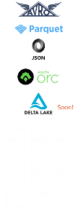
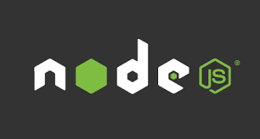



















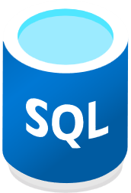
Data Consumption ecosystem
Data Ingestion ecosystem
Query Tools
SDKs
Data Formats
Notebook Connectivity
Managed pipelines
Visualization
Batching
ADX Dashboard
Streaming
API and Client Libraries
REST API
Connection & plugins
Orchestration
Connectors
Tools
TDS, JDBC, ODBC
One Click Ingestion
Export
LightIngest

Slide 10
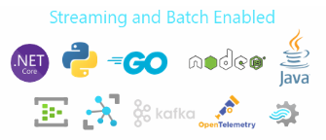


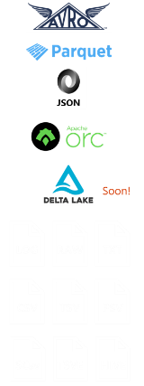




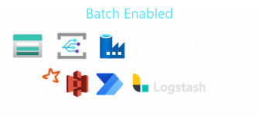





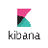

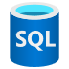





Native Feature
Data Explorer
Real Time Data Analytics Platform
Data Formats
Data Ingestion
Data Explorer Cluster
Data Retrieval
REST API
TDS, JDBC, ODBC
Compute
(with SSD cache)
In-place Transformation
Data Visualization
ADX Dashboard
Analytics Engine
Cross-Query Data Sources
Advanced Analytics & ML
Storage
Compressed Data
Storage
Timeseries Functions
Geospatial
Data Sharing (Follower Cluster)
Enterprise Readiness
Data Encryption, Network Security, RBAC
Multi-tenancy, Azure Active Directory Integration
Availability, Performance, Automation, Monitoring
Security
Running on Azure Platform, Available in 50+ Regions, Ring 1 Service

Slide 11

Enterprise Ready – Mission Critical
Azure Active Directory Integration
Availability Zones
Role based authorization
Auto Scale-Up/In
Synapse Managed Vnet with Data Exfiltration Protection
Globally available
Encryption with customer managed keys
CI/CD Integration
Monitoring
Automated provisioning
Build Azure Policy Support
Notes:
Data Explorer is enterprise ready will all the key capabilities you need get to production.
To fulfill High Availability , we support 3 Azs
Cluster can be scaled using “Optimized Autoscale” option
Will support through entire DevOps journey – CI/CD are part of it
Rich Monitoring through Metrics and Insights blade
Encryption of data both at storage layer(double encryption, customer keys) and compute layer(Disk encryption enabled after cluster is created)
Network security through Vnet injection, Private Endpoints and Managed PEs to azure services like storage, SQL
AAD integration
RBAC roles to control authorization

Slide 12

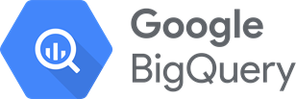



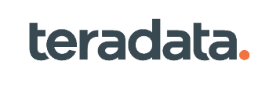
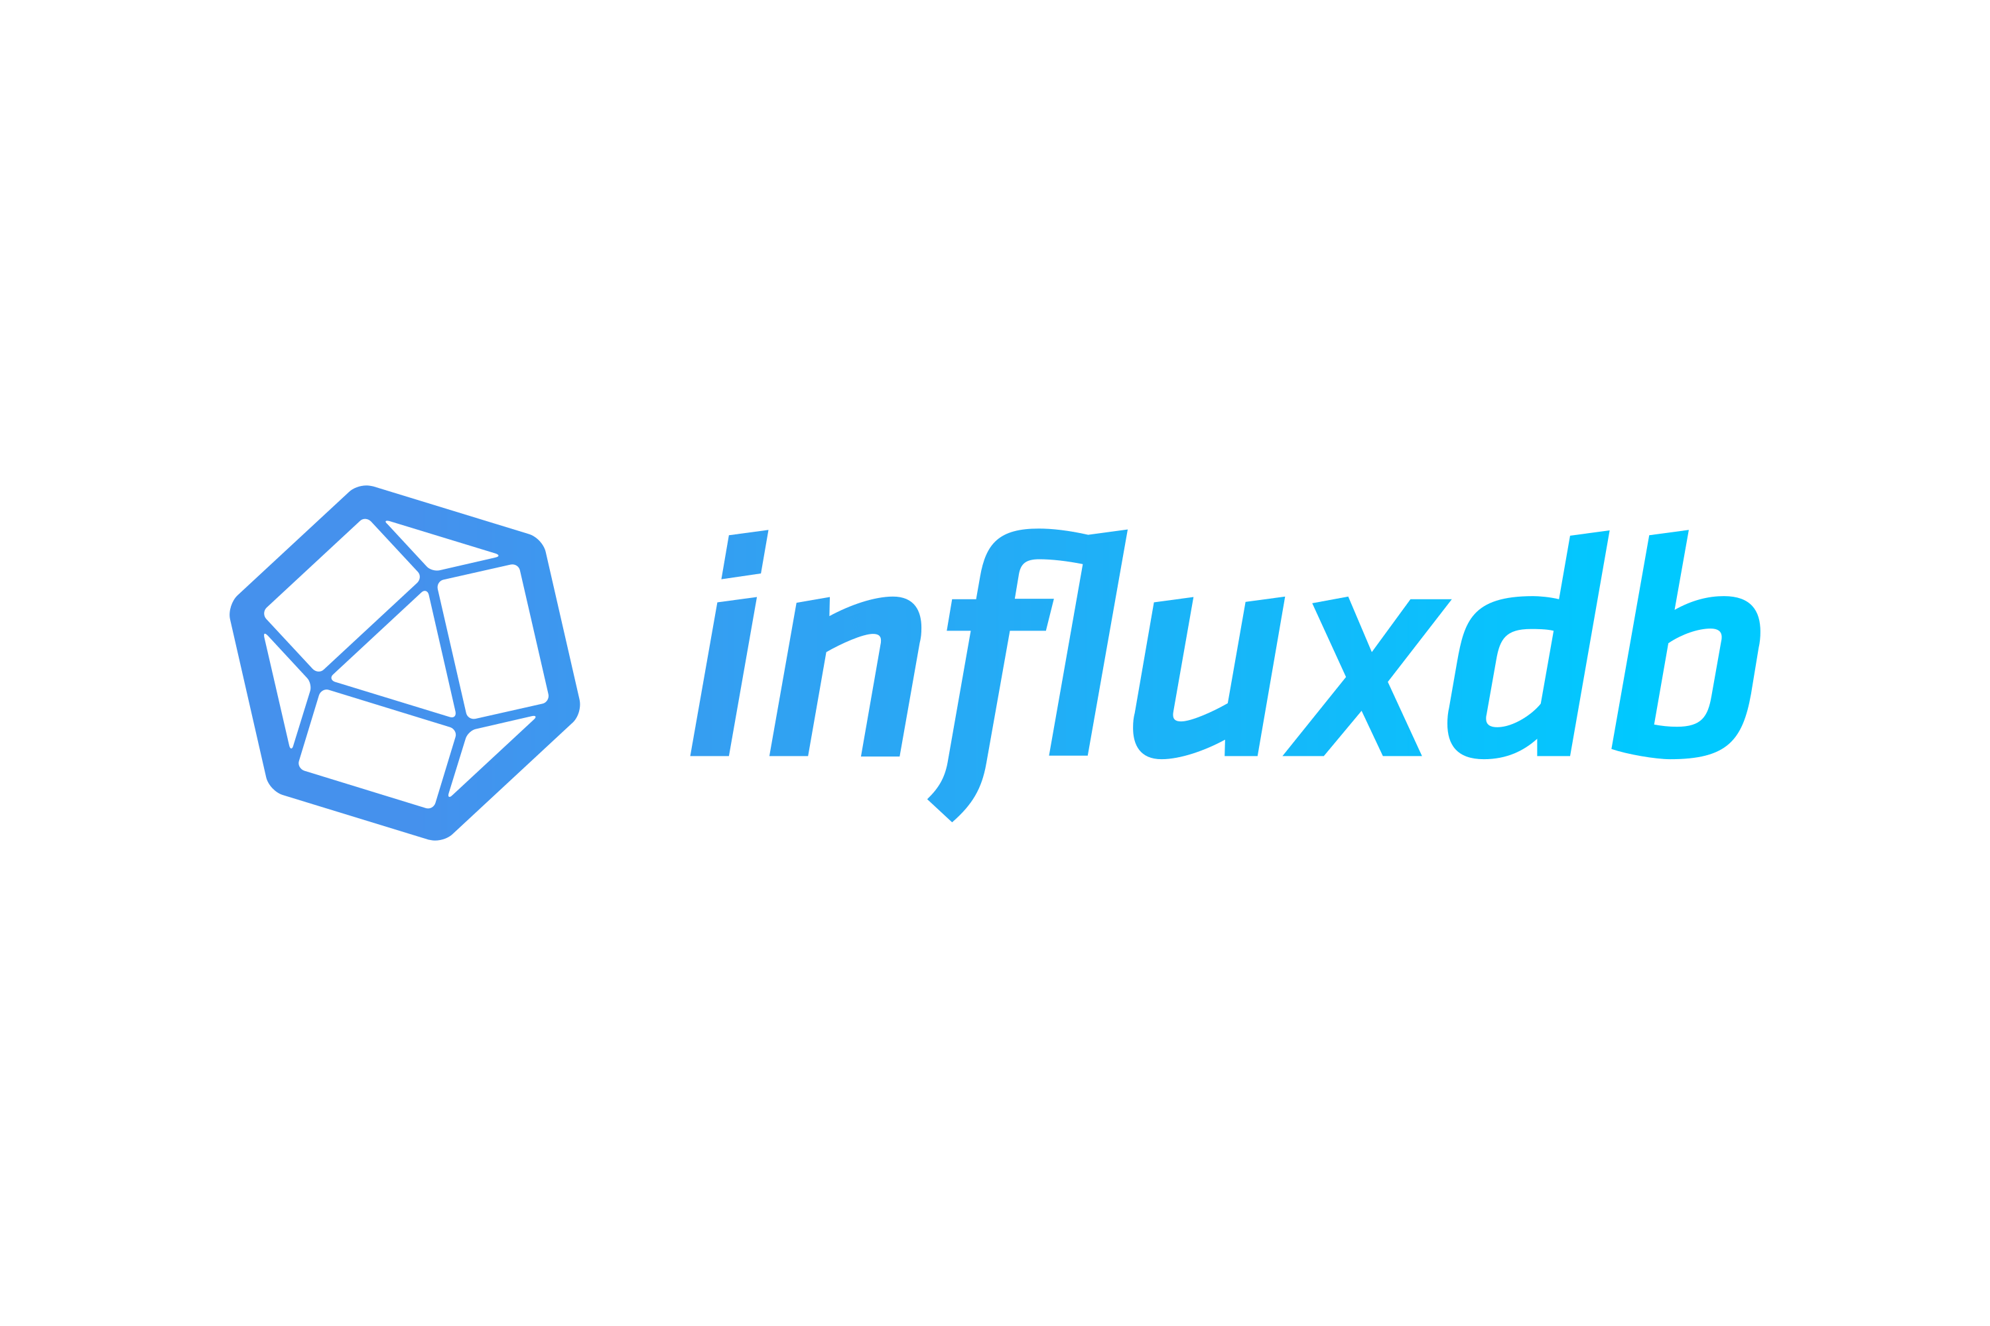
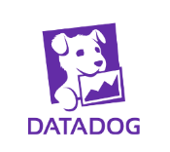

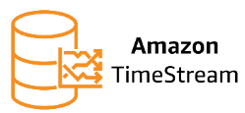
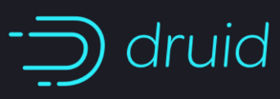

Competitive Hints
ADX for telemetry, logs, time series data
Observability data
SQL Pools for data warehousing workloads
ADX for telemetry, logs, time series data
Cognitive search for natural language
Often with Sentinel for security workloads
Definitely!
ADX for interactive workloads
Notes:
For telemetry and timeseries data we compete with Big Query, snowflake and Teradata
Elastic Search , splunk , data dog also on telemetry data but specially security logs. Example Sentinal is built on ADX. LinkedIn moved from Elastic Search to ADX for Operational Logs, new services onboarding etc
Influx DB, AWS TimeStream are time series DBs. ADX competes in that area too for time series analytics
Generally for interactive analytics we use spark in databricks. ADX can also work with such workloads for low latency, interactive queying, deep analysis, dashboards some ML capabilities too

Slide 13
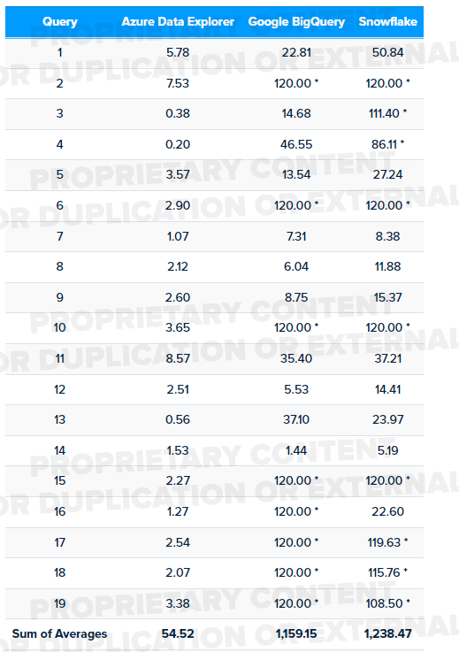
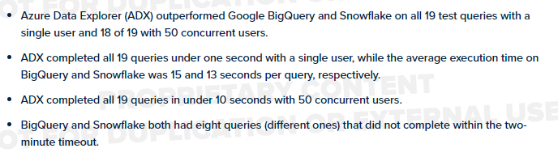
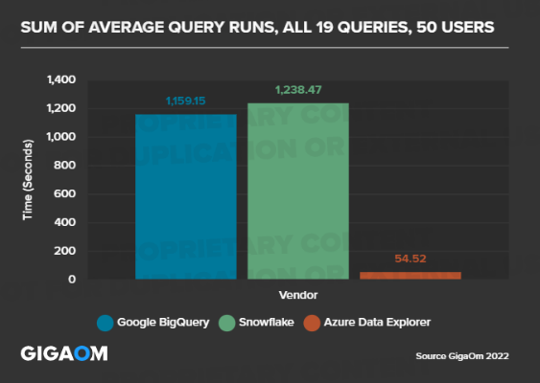
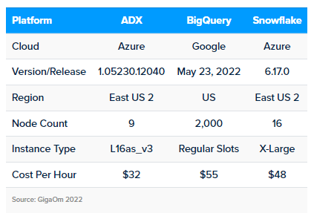
Perf Results: ADX vs BigQuery vs Snowflake
https://aka.ms/adx.benchmark
Log and Telemetry Analytics Performance Benchmark - Gigaom
Notes:
A publicly available benchmark against competes in Gigaom
They selected 19 queries with different complexities to run in ADX, GBQ and snowflake with similar configuration.
ADX outperformed on all the queries and query response avg can be seen to be very less compared to others. Event Cost wise ADX per Hour cost is less compared to GBQ and snowflake

Slide 14

When to use Data explorer? – How does it fit in the intelligence platform?
Observational Analytics
Interactive
Data Warehousing
Kusto
SQL
Well Curated
Pre-processed
Raw Data
Machine Learning
Batch, long running queries, heavy duty model training
ETL
Notes:
In a Data quadrant, If Data needs to be stored in relational format with all integrity constraints, Data warehousing, updates are necessary, Synapse dedicated SQL pool is the right tool
If long running queries, machine learning over large mount of data dated back to 1 year , complex machine learning is necessary, use Synapse Spark pool
If ad-hoc, interactive queries and real time analysis on logs, telemetry is a requirement, use Azure Data Explorer/Synapse Data Explorer

Slide 15
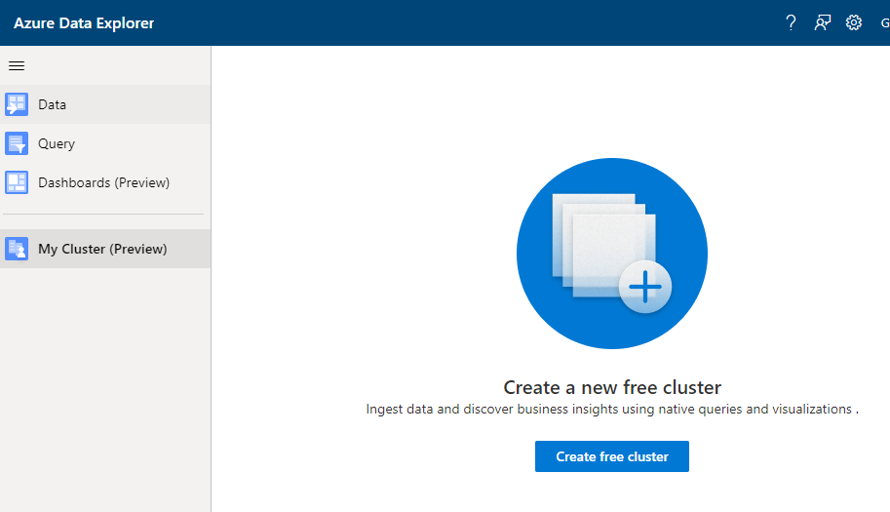
https://aka.ms/adx.free

Slide 16
Personal cluster details
4 vCores, 8GB RAM, ~100GB of data storage (original data)
Up to 10 databases
Up to 100 tables per DB, Up to 200 columns per table
Core functionality

Slide 17
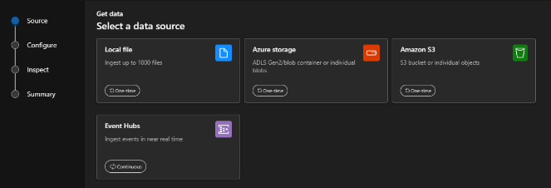
ADX Web UI One-Click (wizard)
Get data from Azure Data Lake, Blob, Event Hub, or local file
Infer the schema automatically from source
Create table and mapping automatically from source
Generate custom code to start ADX project with one of the supported SDKs
Manage data-policies (e.g. retention, batching policies, streaming)
Ingest one-time data or create connection for continuous data ingestion
Continuous (EventHub/EventGrid), one time or backfill (LightIngest)
ADX Web UI
Notes:
Slide is self-explanatory

Slide 18


Ingestion
Module 1 Objectives
After completing this Learning, you will be able to understand:
Deeper ADX Ingestion
Queued
Streaming
Update Policy
Connectors
Light Ingest CLI

Slide 19
Queued Ingestion
Data Explorer > Ingestion
Queued ingestion performs data batching and is optimized for high ingestion throughput.
This is the preferred and most performant ingestion method.
Data is batched according to ingestion properties.
Small batches results in small extents. These extents will be later merged to larger extents, optimized
for fast query results.
Batching policy
Defined on cluster / database / table, inherited
.alter database Metrics policy ingestionbatching @'{"MaximumBatchingTimeSpan":"00:00:30", "MaximumNumberOfItems": 500, "MaximumRawDataSizeMB": 1024}'
Sealing batch by time / size / number of sources limits
If not defined, default values are applied
Notes:
Default cluster ingestion batching policy is 5 minutes, 1000 items and 1024 MBs

Slide 20
Streaming Ingestion
Data Explorer > Ingestion
Streaming ingestion allows near real-time latency for small sets of data per table.
Data is ingestion to row store. In the background, data is later moved to column store extents.
Streaming ingestion mode is enabled via the portal and applied on tables where policy is set.
Streaming ingestion types
Custom ingestion using one of the ADX client libraries
Using Event Hub as a data source
Streaming ingestion policy
Enable on cluster / define on database / table, inherited
.alter database StreamingTestDb policy streamingingestion enable
.alter table TestTable policy streamingingestion enable
Number of row stores should be scaled up as the data rate increases
If not defined, data batching is applied

Slide 21
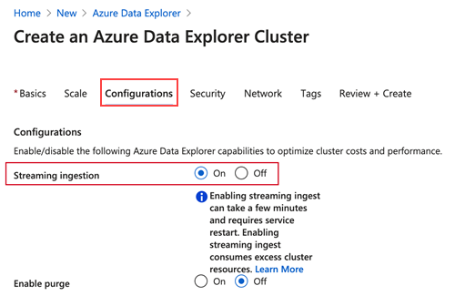
Streaming Ingestion
Data Explorer > Ingestion
Kusto
//create table
.create table TestTable (TimeStamp:datetime, Name:string, Metric:int, Source:string)
//define table policy
.alter table TestTable policy streamingingestion enable
//define database policy
.alter database StreamingTestDb policy streamingingestion enable
//control command
.show table MyTable policy streamingingestion

Slide 22

Batching vs streaming ingestion
Batching
Optimized for high ingestion throughput
Preferred method and most performant
Data is batched according to properties
Set ingestion batching policy on databases or tables
Default max batching value is 5 minutes, 1000 items or total of 1 GB
4 GB data size limit for a batch ingestion command
Streaming
Ongoing data ingestion from a streaming source
Near real-time latency for small sets of data per table
Initially ingested to row store
Then moved to column store extents
Steaming can be done using ADX client library or supported pipelines
NOTE: The recommendation is to ingest files between 100 MB and 1 GB.
See more: comparing-ingestion-methods-and-tools
Notes:
https://docs.microsoft.com/en-us/azure/data-explorer/ingest-data-overview#batching-vs-streaming-ingestion
Small batches ingested get merged and optimized behind the scenes.

Slide 23








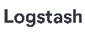

Data Management and Ingestion
1
SDKs
Managed pipelines
Data Explorer
Connections
Batching
Data Explorer
Engine
Data Management
Ingestion
Connection & plugins
Management
Tools
One Click Ingestion
LightIngest
Notes:
You can ingest data in Data Explorer in many ways.
Using our SDKs
Use managed pipelines where Data Explorer will automatically read the data from IoT Hub, EventHub or Storage\Data Lake
Use any of the 1st party connectors and agents to push data from Kafka, Spark, Logstach, PowerApp, FluentBit, and Telegraph agents
Use Azure Data Factory\Synapse Pipelines to bring data from wide variety of sources
Data Explorer support automated batching of the data for efficient ingestion and can ingest up 200 MB/sec csv files per 16 cores compute. It support wide variety of formats such as JSON, Parquet, Orc, Avro and more.
Limitations with current Data Explorer in Synapse:
IoT Hub and Event Grid managed pipelines are not supported when the workspace is created under Managed Vnet.

Slide 24

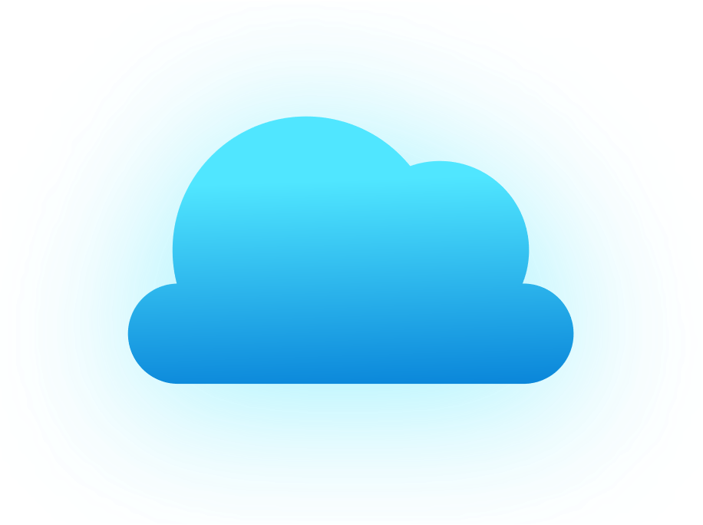


Cross Queries
1
Between Data Explorer databases and clusters
Query SQL pool from Data Explorer
Query Azure Monitor from Data Explorer
Query Cosmos DB from Data Explorer
Query Data Lake from Data Explorer
Notes:
You may have scenarios where you may want to create multiple Data Explorer clusters for storing different types of data or host different pool is different regions or different divisions in your company many have their own Data Explore clusters.
In all these scenarios cross database\cluster enable you to easily cross query between database, between ADX clusters in same region or other regions.
Data Explorer is integrated with rest of the Azure ecosystem, in cases where you don’t want to ingest the data in Data Explorer – you can query it easily from SQL, Azure Monitor, Cosmos DB, and Data Lake.

Slide 25


Data Sharing
1
Share data within the company
Load balancing
Data-as-a-service
Hub and Spoke model
Chargeback
Ingest
Query
Query
Leader
Follower
Follower
No Maintenance
In-Place Data Sharing
No data pipeline to maintain
Near real-time updates
Symbolic link
R/W
R/W
R/W
R
R/W
DB1
DB2
DB3
DB3
DB4
Compute
Compute
Azure Blob Storage
Azure Blob Storage
Notes:
Thanks to the separation of storage and compute in Data Explorer pool.
You can have one Data Explorer pool for ingesting and querying the data and share the databases with multiple Data Explorer pools.
This enables you to load balance, offer data-as-a-service, build Hub and Spoke model, or chargeback to you internal teams.
Its all automated and real-time caching, you don’t need to maintain any pipeline.

Slide 26
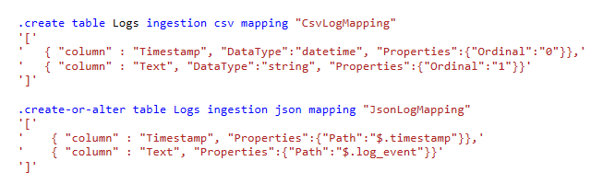
Data Formats and Mapping
Data Explorer > Ingestion
Data formats
Text, Raw
Delimiter separated values: CSV, TSV, TSVE, PSV, SCSV, SOH
JSON (line-separated, multiline)
Avro, Parquet, ORC
Supports ZIP and GZIP compression
Column mapping
Rename, reorder, or skip fields
CSV mapping maps field ordinals to columns
JSON and Avro mappings map field paths to columns

Slide 27
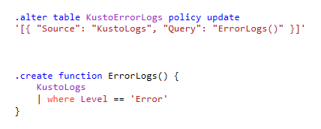
Update Policy
Data Explorer > Ingestion
Used for additional processing over the ingested data or for distributing data between tables.
Invoked whenever new data is appended to the source table.
The query can invoke stored functions.
Scenarios
Filter out data, deduplication
Created calculated columns, changing schema
Different retention policies for subset of the data

Slide 28
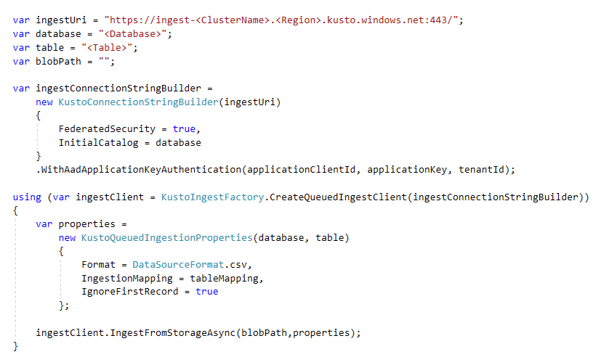
Ingest SDKs
Data Explorer > Ingestion
Ingest client libraries are used for performing queued ingestion.
Data is uploaded to a blob and a message is posted to the Data Management service queue.
The message contains reference to the blob, mandatory ingestion properties (Database, Table) and optional ingestion properties (Format, IngestionMapping etc.)
SDKs
.NET Standard
Python
Node.js
Java
REST API
Go

Slide 29
Connectors and Plugins
Data Explorer > Ingestion
ADX Connector for Apache Spark
Open-source project: https://github.com/Azure/azure-kusto-spark
The connector for Spark implements data source and data sink for moving data across ADX and Spark clusters to use both of their capabilities.
ADX Kafka Sink
Opensource project: https://github.com/Azure/kafka-sink-azure-kusto
Micro-batching and ingesting data using Java Kusto Ingest SDK
Logstash
The Logstash output plugin communicates with Azure Data Explorer and sends the data to the service.
FluentBit
Opensource project: https://docs.fluentbit.io/manual/pipeline/outputs/azure_blob
Send logs to Blob and use Event Grid to ingest to Data Explorer
Telegraf: https://github.com/influxdata/telegraf/tree/master/plugins/outputs/azure_data_explorer

Slide 30
Connectors and Plugins
Data Explorer > Ingestion
Logic App / Power Automate: Kusto (ADX) connector
The Azure Kusto connector allows users to run Kusto queries and commands automatically as part of a scheduled or triggered task
Azure Data Factory (ADF)\Synapse Pipelines
A cloud-based data service that allows you to integrate different data stores and perform activities on the data. Supported activities for ADX: Copy, Lookup, Command
Copy in bulk from a database template
Mapping Data Flow

Slide 31
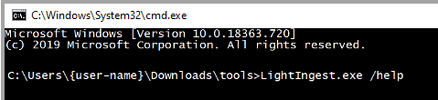
Tools
Data Explorer > Ingestion
Light Ingest
CLI Command tool to ingest data from Azure Storage into ADX
Backfill
LightIngest "Data Source=https://ingest-demo.westus.kusto.windows.net;AAD Federated Security=True" -db:demo -table:Trips -source:"" -pattern:"*.csv.gz" -format:csv -limit:2 -ignoreFirst:true -cr:10.0 -dontWait:true
LightIngest "Data Source=https://ingest-demo.eastus.kusto.windows.net;AAD Federated Security=True" -db:demo -table:Trips -source:"https://demo.blob.core.windows.net/adx" -creationTimePattern:"'historicalvalues'yyyyMMdd'.parquet'" -pattern:"*.parquet" -format:parquet -limit:2 -cr:10.0 -dontWait:true
See More: How to ingest data using CreationTime
Notes:
A blob name that contains the datetime as follows: historicalvalues19840101.parquet (the timestamp is four digits for the year, two digits for the month, and two digits for the day of month),
The value for -creationTimePattern argument is part of the filename: "'historicalvalues'yyyyMMdd'.parquet’”
ingest-{Cluster name and region}.kusto.windows.net;AAD Federated Security=True -db:{Database} -table:Trips -source:"https://{Account}.blob.core.windows.net/{ROOT_CONTAINER};{StorageAccountKey}" -creationTimePattern:"'historicalvalues'yyyyMMdd'.parquet'"
-pattern:"*.parquet" -format:parquet -limit:2 -cr:10.0 -dontWait:true
For a blob URI that refers to hierarchical folder structure, like https://storageaccount/container/folder/2002/12/01/blobname.extension,
The value for -creationTimePattern argument is part of the folder structure: "'folder/'yyyy/MM/dd'/blob’”
ingest-{Cluster name and region}.kusto.windows.net;AAD Federated Security=True -db:{Database} -table:Trips -source:"https://{Account}.blob.core.windows.net/{ROOT_CONTAINER};{StorageAccountKey}" -creationTimePattern:"'folder/'yyyy/MM/dd'/blob'"
-pattern:"*.csv.gz" -format:csv -limit:2 -ignoreFirst:true -cr:10.0 -dontWait:true
Ref: https://docs.microsoft.com/azure/data-explorer/lightingest#how-to-ingest-data-using-creationtime

Slide 32
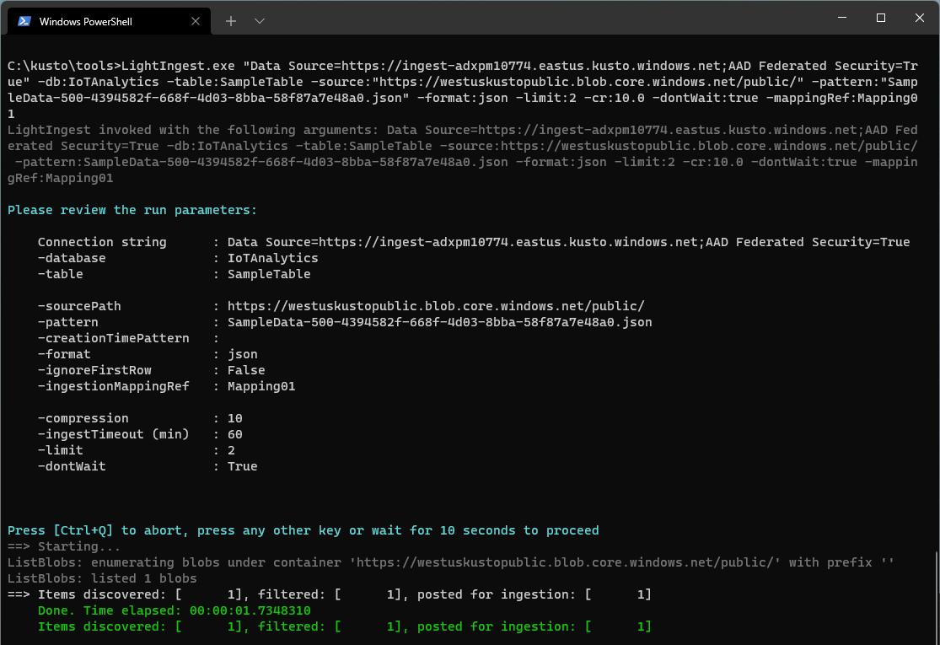
Light Ingest CLI
Data Explorer > Ingestion
Notes:
A blob name that contains the datetime as follows: historicalvalues19840101.parquet (the timestamp is four digits for the year, two digits for the month, and two digits for the day of month),
The value for -creationTimePattern argument is part of the filename: "'historicalvalues'yyyyMMdd'.parquet’”
ingest-{Cluster name and region}.kusto.windows.net;AAD Federated Security=True -db:{Database} -table:Trips -source:"https://{Account}.blob.core.windows.net/{ROOT_CONTAINER};{StorageAccountKey}" -creationTimePattern:"'historicalvalues'yyyyMMdd'.parquet'"
-pattern:"*.parquet" -format:parquet -limit:2 -cr:10.0 -dontWait:true
For a blob URI that refers to hierarchical folder structure, like https://storageaccount/container/folder/2002/12/01/blobname.extension,
The value for -creationTimePattern argument is part of the folder structure: "'folder/'yyyy/MM/dd'/blob’”
ingest-{Cluster name and region}.kusto.windows.net;AAD Federated Security=True -db:{Database} -table:Trips -source:"https://{Account}.blob.core.windows.net/{ROOT_CONTAINER};{StorageAccountKey}" -creationTimePattern:"'folder/'yyyy/MM/dd'/blob'"
-pattern:"*.csv.gz" -format:csv -limit:2 -ignoreFirst:true -cr:10.0 -dontWait:true
Ref: https://docs.microsoft.com/azure/data-explorer/lightingest#how-to-ingest-data-using-creationtime

Slide 33
Demo*
One-click ingestion CSV
.create table ingestion json mapping
.ingest into table from blob
* Estimate 5-10 minutes
Notes:
Instructor Steps: https://dev.azure.com/CEandS/Azure-Data-Explorer/_wiki/wikis/ADX-with-IoT-Analytics/1105/Demos?anchor=module-1---adx-ingestion
https://youtu.be/Bx6M93K9siE?t=100
https://msit.microsoftstream.com/video/1776a78a-515f-481d-b03d-70f13628ef04?st=1421
Ref:
https://docs.microsoft.com/azure/data-explorer/ingest-sample-data?tabs=one-click-ingest
https://docs.microsoft.com/azure/data-explorer/kusto/management/data-ingestion/ingest-from-storage

Slide 34
Knowledge check - Azure Data Explorer
What best describes the ADX?
Big data storage data optimized for batching non-interactive queries.
Big data solution for data transformations.
Big data analytics cloud platform optimized for high volume, interactive queries.
What is a control command in ADX?
Control commands can be used for maintenance and policy tasks.
A query.
A way to visualize data.
Which of the following is an appropriate use case for ADX?
Log and Text analytics
In-memory batching processing of petabytes of information.
Real-time analytics
Which aspect of an extract, transform, and load (ETL) process makes it unsuitable for ADX.
Long running tasks.
Large volumes of data for ingestion.
High query concurrency.
Notes:
Answers: c, a, a, a
c. ADX is a big data analytics platform that makes it easy to analyze high volumes of data in near real-time.
a. Control commands include the creation of new cluster or databases, data connections, auto scaling, cluster configurations, entities, metadata objects, and security policies.
a. This is an excellent use case for Azure Data Explorer.
a. Azure Data Explorer is not optimized for long running tasks. As such running massive nightly ETL jobs on Azure Data Explorer is not recommended.

Slide 35
Product Links
Product
Product Page: http://aka.ms/AzureDataExplorer
Docs: https://aka.ms/adx.docs
Cost Estimator: http://aka.ms/adx.cost
Free Courses: KQL from Scratch, Azure data exploring, How to start with Azure Data Explorer (blog), Advanced KQL (blog)
Lab: https://aka.ms/adx.lab
Whitepaper: https://azure.microsoft.com/en-us/resources/azure-data-explorer/en-us/
101 blog: https://azure.microsoft.com/en-us/blog/azure-data-explorer-technology-101/
Trial Cluster - http://aka.ms/adx.try
Reference Architectures - https://aka.ms/adx.architectures
Social and Community
Twitter: @AzDataExplorer
Tech Community Blog: https://aka.ms/adx.blog
Tech Community Forum: http://aka.ms/adx.techcommunity
Stack overflow: https://aka.ms/adx.sof
YouTube Channel: https://aka.ms/adx.youtube
Make product suggestions: https://aka.ms/AzureDataExplorer.UserVoice

Slide 36
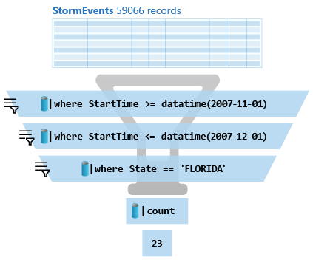
What is a Kusto query?
A Kusto query is a read-only request to process data and return results.
Has one or more query statements and returns data in a tabular or graph format.
Statements are sequenced by a pipe (|). Data flows, or is piped, from one operator to the next.
The data is filtered/manipulated at each step and then fed into the following step. It's like a funnel, where you start out with an entire data table.
Each time the data passes through another operator, it's filtered, rearranged, or summarized.

Slide 37
KQL Concepts
Relational operators (filters, union, joins, aggregations, …)
Each operator consumes tabular input and produces tabular output
Can be combined with ‘|’ (pipe).
Similarities: OS shell, Linq, functional SQL…
Ease to write, read, change
Statements:
Multi-statement (‘;’) queries
Single statement query
Use ‘let’ for reusing statements

Slide 38
KQL Basic operators for data exploration
… | count
Counts records in input table (e.g. T)
… | take 10
Get few records - convenient to start get familiar with the data
No actual order ensured
… | where Timestamp > ago(1) and UserId == ‘abdcdef’
Filtering on a specific fields
… | project Col1, Col2, …
Choose some columns (great if input table has dozens of coluns)
…| extend NewCol1=Col1+Col2
Introduces new calculated columns
… | render timechart
Plot the data (in KE and KWE) while exploring

Slide 39
SQL to KQL
Try the ‘EXPLAIN’ operator as follows
EXPLAIN SELECT COUNT_BIG(*) as C FROM LogisticsTelemetry
Use SQL to KQL Cheat Sheet
Growth mindset 😇

Slide 40
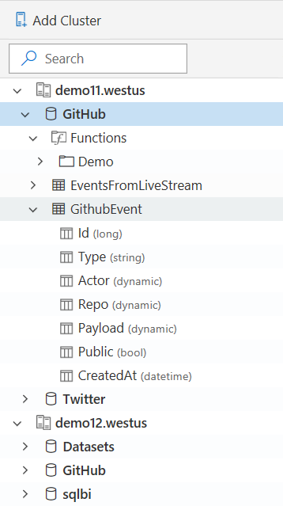
Schema
Schema is
Relational, Lightweight, Dynamic
Databases
Authorization boundary
Transaction boundary
But not query boundary!
Supporting cross-database and cross-cluster queries
Tables
Rectangular
Columns
Supported types: boolean, integer, real, decimal, dates, timespan, string, dynamic (JSON)
Stored functions (views)
Materialized views

Slide 41
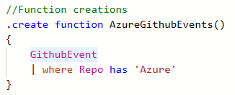
Stored Functions (stored procedures/views)
Essence: Reusable function, defined and used in a Database scope
View is parameter-less function
Schema: scalar or tabular
Special powers: Can override table with the same name.
Safe and Secure: Control commands are forbidden.
Applications:
Sharing queries between users/applications
Abstracting complex logic from other applications
SQL-compat tools connecting to Kusto via Views to run high perf queries

Slide 42
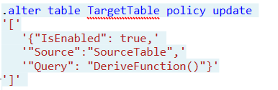
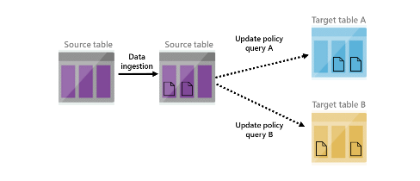
Update Policy (inner ETL/Trigger)
Essence: Triggered ingestion into another table.
Semantics: Attached to ‘target’ table and points on ‘source’ table. Transformation is an arbitrary Kusto query.
Special powers: Source table is scoped to the newly ingested data only.
Applications:
Transform data schema (lightweight ETL)
De-multiplexing data stream into several tables
Use target tables with longer retention
Reduce duplications
Notes:
<Gilles> Update policy is like an internal ETL. It can help you manipulate or enrich the data as it gets ingested into the source table (e.g. extracting JSON into separate columns, creating a new calculated column, joining the new records with a static dimension table that is already in your database, etc). For these cases, using an update policy is a very common and powerful practice. Each time records get ingested into the source table, the update policy's qeury (which we'll define in the update policy) will run on them (and only on newly ingested records - other existing records in the source table aren’t visible to the update policy when it runs), and the results of the query will be appended to the target table.
When you trigger an update policy with a command that adds data to a source table, data also appends to a target table. The target table can have a different schema, retention policy, and other policies from the source table. For example, a high-rate trace source table can contain data formatted as a free-text column. The target table can include specific trace lines, with a well-structured schema generated from a transformation of the source table's free-text data using the parse operator.
Performance impact
Update policies can affect cluster performance, and ingestion for data extents is multiplied by the number of target tables. It's important to optimize the policy-related query. You can test an update policy's performance impact by invoking the policy on already-existing extents, before creating or altering the policy, or on the function used with the query.

Slide 43
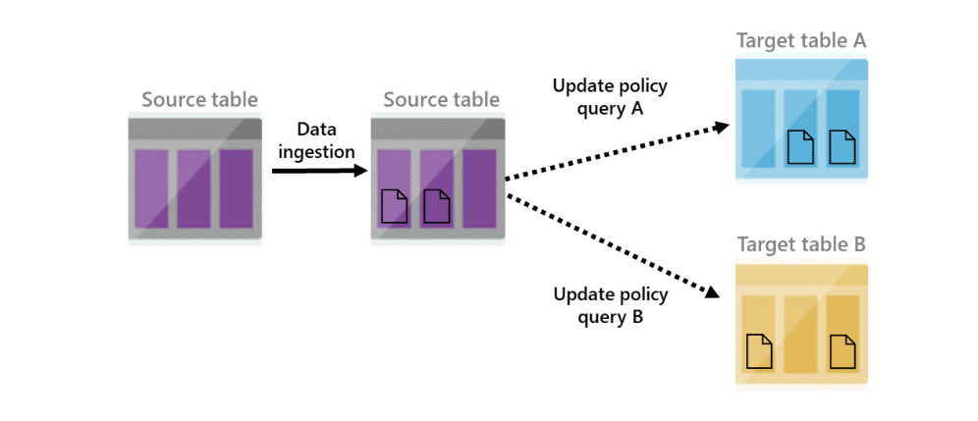
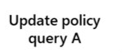

Update Policy
IngestionLogs (244854 records)
ManiputatelogsRaw() filters the newly ingested data
logsRaw
logsRaw + new 3834012 ingested records (not filtered)
Notes:
<Gilles> Source table 'logsRaw' must be referenced in update policy query
Update policy is like an internal ETL. It can help you manipulate or enrich the data as it gets ingested into the source table (e.g. extracting JSON into separate columns, creating a new calculated column, joining the new records with a static dimension table that is already in your database, etc). For these cases, using an update policy is a very common and powerful practice. Each time records get ingested into the source table, the update policy's qeury (which we'll define in the update policy) will run on them (and only on newly ingested records - other existing records in the source table aren’t visible to the update policy when it runs), and the results of the query will be appended to the target table.
When you trigger an update policy with a command that adds data to a source table, data also appends to a target table. The target table can have a different schema, retention policy, and other policies from the source table. For example, a high-rate trace source table can contain data formatted as a free-text column. The target table can include specific trace lines, with a well-structured schema generated from a transformation of the source table's free-text data using the parse operator.
Performance impact
Update policies can affect cluster performance, and ingestion for data extents is multiplied by the number of target tables. It's important to optimize the policy-related query. You can test an update policy's performance impact by invoking the policy on already-existing extents, before creating or altering the policy, or on the function used with the query.

Slide 44
ADX-in-a-Day Guidelines
This is not a hands-on lab. It’s a combination of a lab and a hack. So, use the links, hints, try to solve, or raise your hands.
Screenshots are just examples. Your output may not exactly match the screenshots provided.
Please read the instructions carefully.
Badges will be issued within 24 hours
Submission deadline: before Friday, 21 April 2023, 5 pm CET

Slide 45
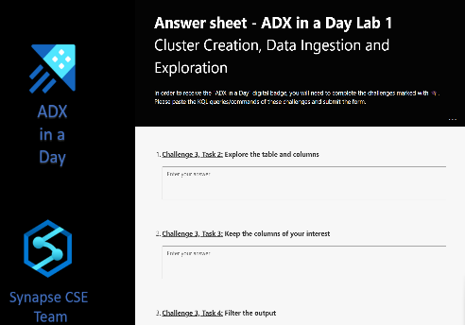
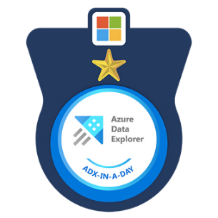
ADX-In-A-Day resources
ADX in a Day – GitHub page
Answer sheet forms
Lab 1
Lab 2
Lab 1 Answer Sheet
Lab 2 Answer Sheet

